Slide 1
Version Control
Team Based Project ( MOD008917 )

Slide 2
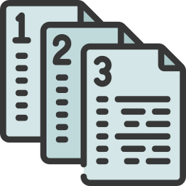
Why Do I Need Version Control?
A type of “undo” button.
A type of backup.
A type of parallel usage.
A type of audit.

Slide 3
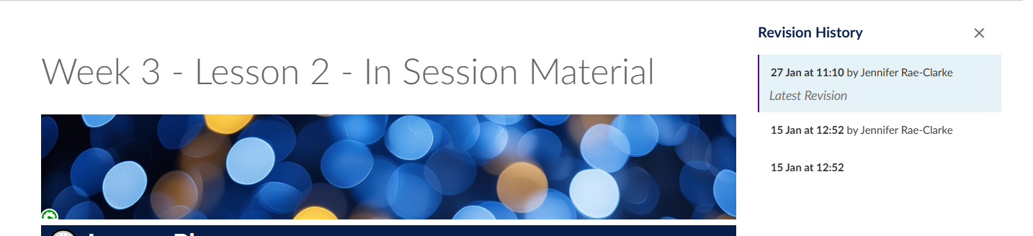
“Undo” Button
I was making some pages for your Canvas module and accidentally overwrote a completed page, with the copy/paste from a different page, and saved it.

Slide 4
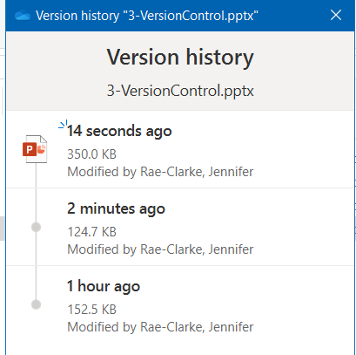
Backup
I was writing a huge set of instructions out in a Word document and saved regularly to OneDrive. One evening my laptop ran out of power and the file didn’t recover with the unsaved changes.

Slide 5
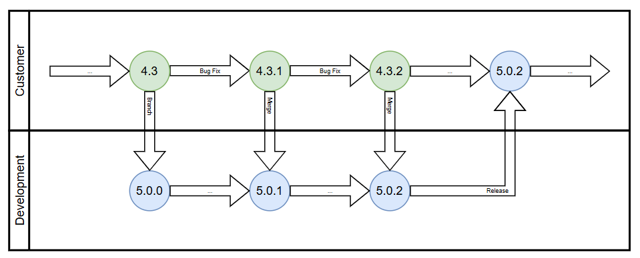
Parallel Usage
While I was working testing on the next big release of software (version 5.0) the customers were still using an earlier version (version 4.3). We were also deploying bug fixes to the customers version which we later had to merge into our new version again.

Slide 6
Audit
While I was managing a team, I made changes to our department processes. When a piece of software had a bug found due to a “missed process”, I could show that the changes to improve the processes had been made after the software deployed and this was a historical issue, not a current issue.
Software Deployed: 01/01/2020
Processes Updated: 20/02/2021

